Slide 1
Computer Networks
“DATA LINK LAYER - 3”
Asst. Lect. Ahmed M. Jasim
Computer Department - College of Engineering
University of Diyala
2017

Slide 2
FLOW CONTROL
Consider a situation in which the sender transmits frames faster than the receiver can accept them.
If the sender keeps pumping out frames at high rate, at some point the receiver will be completely swamped and will start losing some frames.
This problem may be solved by introducing flow control.
Most flow control protocols contain a feedback mechanism to inform the sender when it should transmit the next frame.

Slide 3
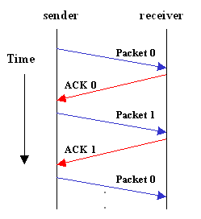
FLOW CONTROL
Mechanisms for Flow Control
1- Stop and Wait Protocol
Stop-and-wait is also known as Request/reply.
This is the simplest control protocol in which the sender transmits a frame and then waits for an acknowledgement, either positive or negative, from the receiver before proceeding.

Slide 4
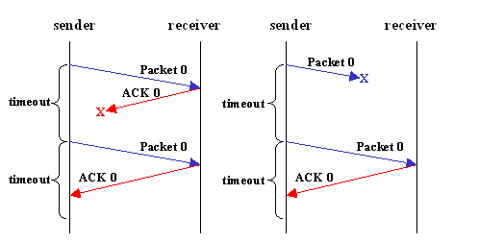
FLOW CONTROL

Slide 5
FLOW CONTROL
In spite of the use of timers, the stop and wait protocol still suffers from a few drawbacks.
Firstly, if the receiver had the capacity to accept more than one frame, its resources are being underutilized.
Secondly, if the receiver was busy and did not wish to receive any more packets, it may delay the acknowledgement. However, the timer on the sender's side may go off and cause an unnecessary retransmission.
These drawbacks are overcome by the
sliding window protocols.

Slide 6
FLOW CONTROL
2- Sliding Window Protocols:
In sliding window protocols the sender's data link layer maintains a (sending window) which consists of a set of sequence numbers corresponding to the frames it is permitted to send.
Similarly, the receiver maintains a (receiving window) corresponding to the set of frames it is permitted to accept.
The window size is dependent on the retransmission policy and it may differ in values for the receiver's and the sender's window.
The sequence numbers within the sender's window represent the frames sent but as yet not acknowledged.

Slide 7
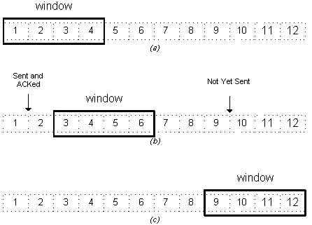
FLOW CONTROL
Whenever a new packet arrives from the network layer, the upper edge of the window is advanced by one.
When an acknowledgement arrives from the receiver the lower edge is advanced by one.

Slide 8
FLOW CONTROL
The receiver's window corresponds to the frames that the receiver's data link layer may accept.
When a frame with sequence number equal to the lower edge of the window is received, it is passed to the network layer, an acknowledgement is generated and the window is rotated by one.
However, a frame falling outside the window is received, the receiver's data link layer has two options.
It may either discard this frame and all subsequent frames until the desired frame is received
Or
it may accept these frames and buffer them until the appropriate frame is received and then pass the frames to the network layer in sequence.

Slide 9
FLOW CONTROL
Most sliding window protocols also employ ARQ (Automatic Repeat reQuest) mechanism. In ARQ, the sender waits for a positive acknowledgement before proceeding to the next frame. If no acknowledgement is received within a certain time interval it retransmits the frame.
ARQ is of two types:
Go-Back-N ARQ Protocol
Selective Repeat

Slide 10
FLOW CONTROL
1- Go-Back-N ARQ Protocol
If a frame is lost or received in error, the receiver may simply discard all subsequent frames, sending no acknowledgments for the discarded frames.
In this case the receive window is of size 1.
Since no acknowledgements are being received the sender's window will fill up, the sender will eventually time out and retransmit all the unacknowledged frames in order starting from the damaged or lost frame.

Slide 11
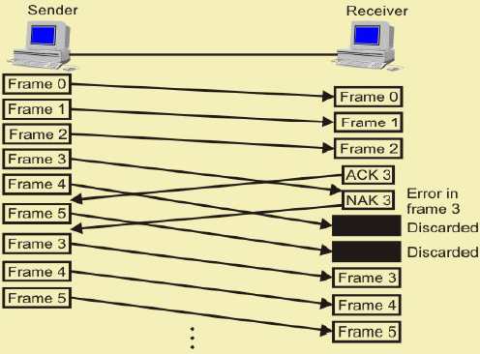
FLOW CONTROL
Frames in error in Go-Back-N ARQ

Slide 12
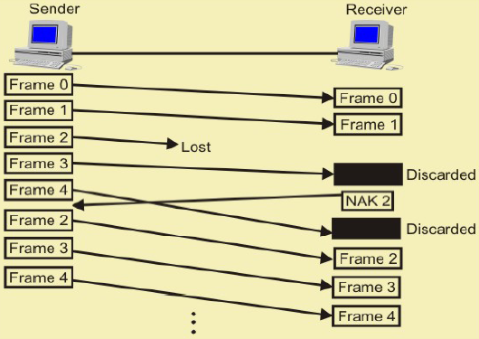
FLOW CONTROL
Lost Frames in Go-Back-N ARQ

Slide 13
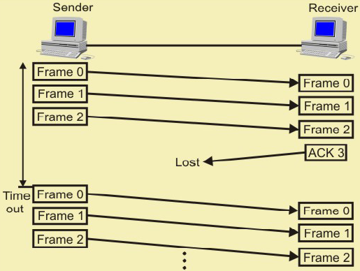
FLOW CONTROL
Lost Frames in Go-Back-N ARQ

Slide 14
FLOW CONTROL
The maximum window size
Assume that the window size (w) of the sender is n.
So the window will initially contain the frames with sequence numbers from 0 to (w-1).
Consider that the sender transmits all these frames and the receiver's data link layer receives all of them correctly.
However, the sender's data link layer does not receive any acknowledgements as all of them are lost.
So the sender will retransmit all the frames after its timer goes off. However, the receiver window has already advanced to w.
Hence to avoid overlap, the size of window should be less than the sequence number space.

Slide 15
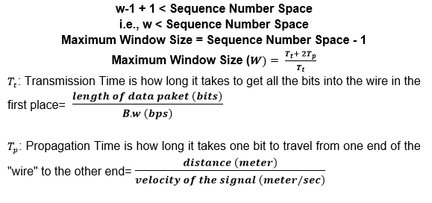
FLOW CONTROL

Slide 16
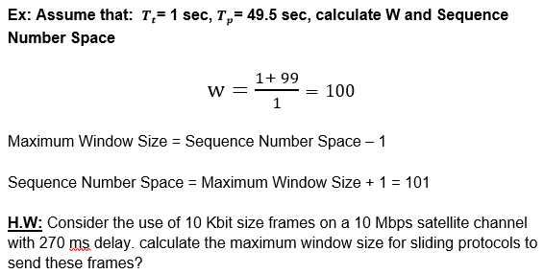
FLOW CONTROL

Slide 17
FLOW CONTROL
2- Selective Repeat
In this protocol rather than discard all the subsequent frames following a damaged or lost frame, the receiver's data link layer simply stores them in buffers.
When the sender does not receive an acknowledgement for the first frame it's timer goes off after a certain time interval and it retransmits only the lost frame.
Assuming error - free transmission this time, the sender's data link layer will have a sequence of a many correct frames which it can hand over to the network layer. Thus there is less overhead in retransmission than in the case of Go Back n protocol.

Slide 18
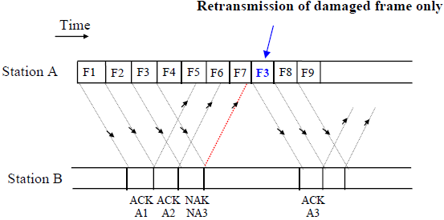
FLOW CONTROL

Slide 19
FLOW CONTROL
The window size
Assume that the size of both the sender's and the receiver's window is w. So initially both of them contain the values 0 to (w-1).
Consider that sender's data link layer transmits all the w frames, the receiver's data link layer receives them correctly and sends acknowledgements for each of them. However, all the acknowledgements are lost and the sender does not advance its window. The receiver window at this point contains the values w to (2w-1).
To avoid overlap when the sender's data link layer retransmits, we must have the sum of these two windows less than sequence number space. Hence, we get the condition:
Maximum Window Size = Sequence Number Space / 2

Slide 20
FLOW CONTROL

Slide 21
THANK YOU

